Slide 1
Project3-Group8
Gabriel Benedict, Qiaqia Sun, Zhengyang Xu, Huiyu Zhang
Notes:
Our names

Slide 2
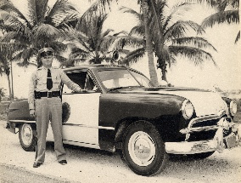

Overview
Setting of the problem
Objectives
Feature Extraction
Modelling
Conclusion
Notes:
Objective: unblur images: from the top to the bottom image

Slide 3
Data
1500 picture pairs
¾ training and validation : cross-validation
¼ Testing
Ground truth
predicted
input

Slide 4


Objectives
1
Portability
2
Computational efficiency
3
Minimize error
Holding storage and memory cost
Cross-validation running time
Test running time
PSNR
with

Slide 5
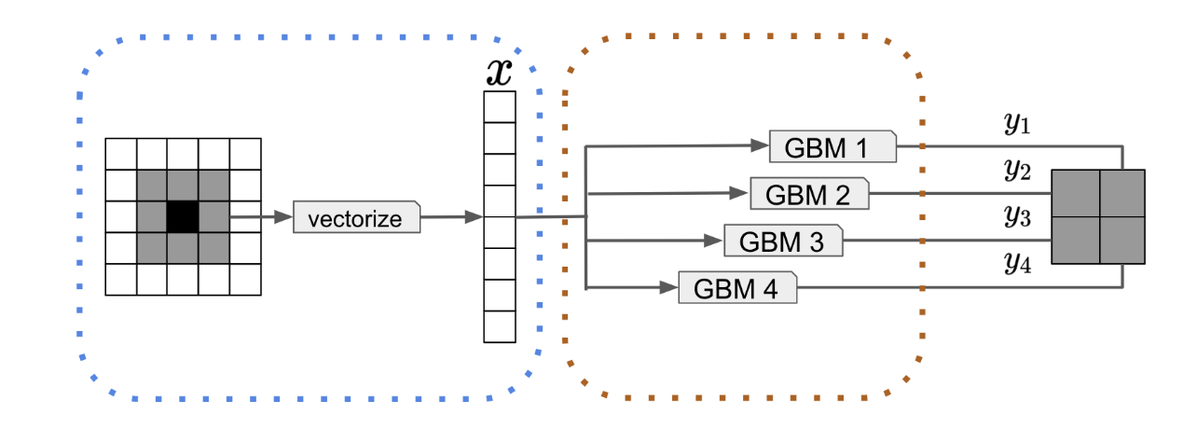
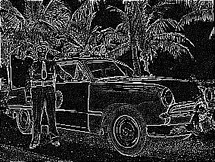
Feature Extraction
Laplace Transform
300 pixels
1 | 1 | 1
1 | -8 | 1
1 | 1 | 1
Notes:
Specifically, in feature selection part, we implemented Lagrange transformation to training pictures, in order to find the most representative points in each picture and sampled them as our training data points. Then after building models using training data, through cross validation for each model (mentioned above), we got the best parameters for each model according to the cross validation error, then implemented each model with their best parameters on testing pictures. Finally, according to the PSNR value of each model, we found the best model in super resolution problem is .

Slide 6
Modelling
Training Image
Feature extraction
Model training
Predicted
Model
Test Image

Slide 7
Four Models
Random Forest
GBM
Neural Network
SVM

Slide 8
Random Forest
TOO SLOW
Construct a multitude of decision trees at training time and outputting the class or the mean prediction of the individual trees.

Slide 9
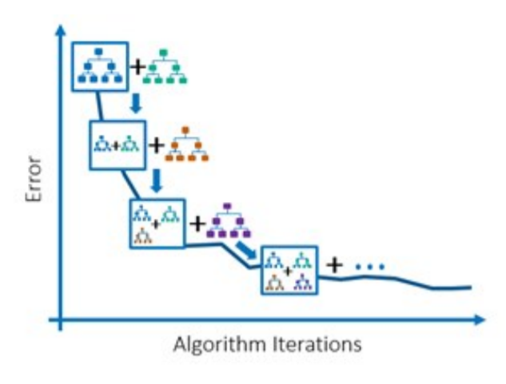
Gradient Boosting Machine
The gradient boosting algorithm adds sub-models to the ensemble incrementally to minimize the loss function

Slide 10
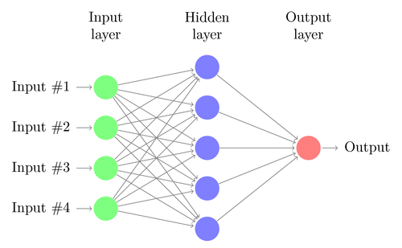
Neural Network

Slide 11
SVM
TOO SLOW
Support vector machines are supervised learning models with associated learning algorithms that analyze data used for classification and regression analysis

Slide 12
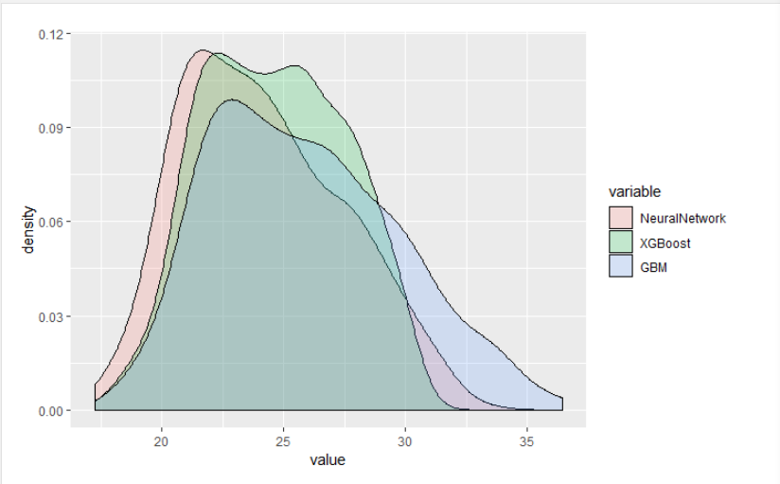
Performance Measure (PSNR)
Means
Gbm: 25.86
Xgboost:
24.63
Neural network:
24.13

Slide 13
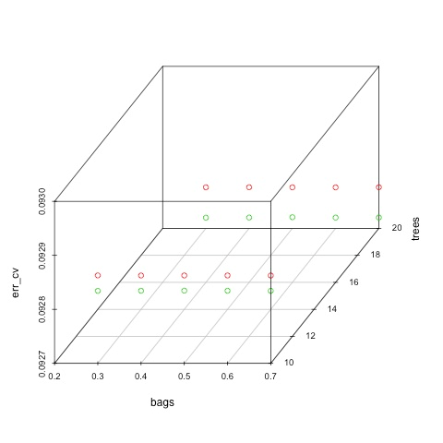
Performance Measure

Slide 14


Conclusion: GBM
LR
Predicted

Slide 15
Further Improvement:
Bigger training data
More pixels around the central pixel to be predicted

Slide 16
References
Natekin, Alexey and Alois Knoll. “Gradient boosting machines, a tutorial” Frontiers in neurorobotics vol. 7 21. 4 Dec. 2013, doi:10.3389/fnbot.2013.00021
Johansson, Richard. “An intuitive explanation of gradient boosting” http://www.cse.chalmers.se/~richajo/dit865/files/gb_explainer.pdf
Ridgeway, Greg. Generalized Boosted Models: A guide to the gbm package http://www.saedsayad.com/docs/gbm2.pdf

Slide 17
Thank you
Notes:
Our names

